Slide 1
CCBD Assignment Task 1 and 3
Abhishek Das PES1201800177
Bhargav SNV PES1201800308
N Sanketh Reddy PES1201800389

Slide 2
Bengaluru’s Greenest Part
Task3

Slide 3
Dataset Creation
Google Maps was used to get images.
Images were captured for each pin code in the City. (Screenshots were taken)
The screenshots were then processed to give only the required area of the map.
Each of the resulting images were further cropped on basis of locality. E.g.: Central, North, South-West, etc.
1.
Image Capture
2.
Image Cropping
3.
Image Splitting

Slide 4


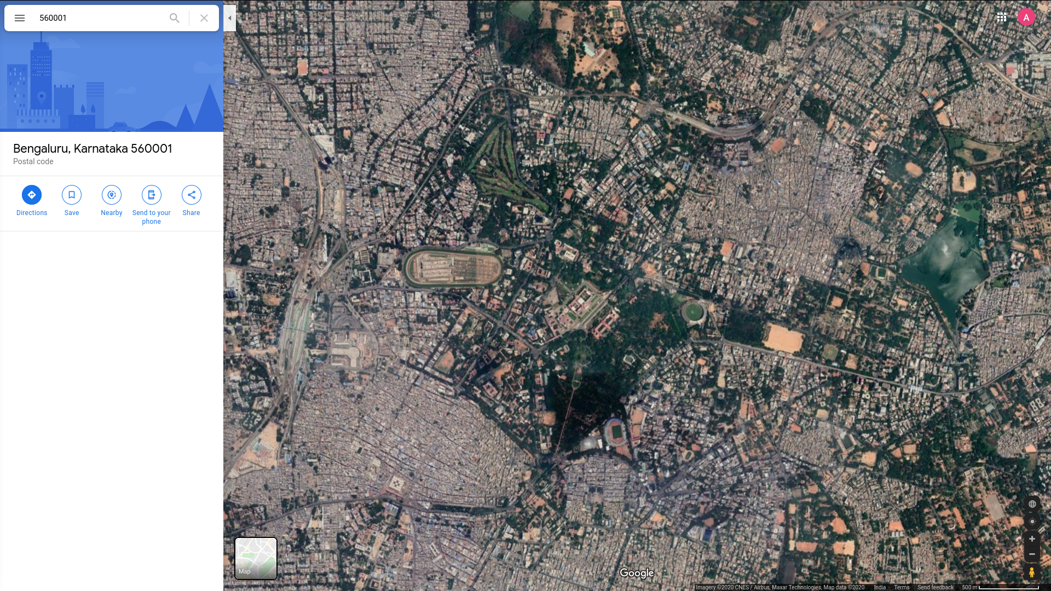
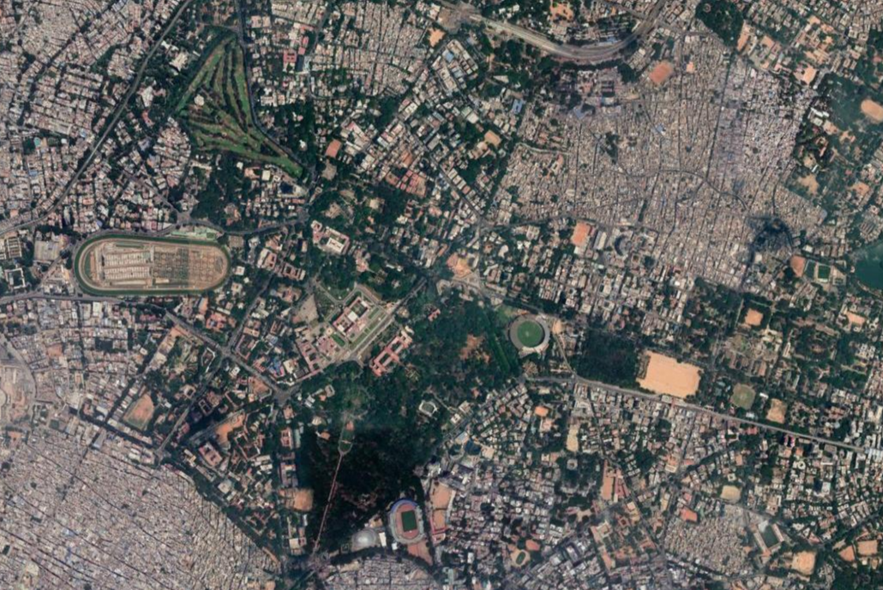




Image Processing Workflow
Screenshot
Cropped Image
Cropped Sector
Sector Mask

Slide 5
Image Processing Implementation
A green mask is acquired for each sector using a threshold HSV value (Specific to green).
This mask results in a black and white image where all green pixels are white and pixels of any other colour are black.
The percentage of green pixels is found and stored into a file.

Slide 6
Hadoop Cluster setup and MapReduce
A 3-node Hadoop Cluster was setup using Vagrant. (3 Virtual Machines running Hadoop)
MapReduce was run over the image processing output.
VM 1
(Master)
VM 2
(Slave 1)
DataNode
NameNode
VM 2
(Slave 1)
DataNode
DataNode

Slide 7
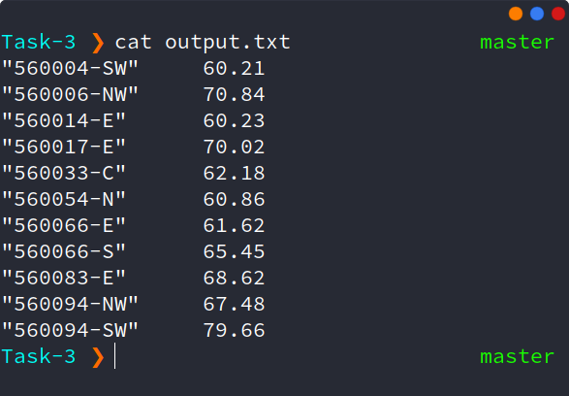
Results
The picture lists places above Bangalore that have above 60% Greenery.
Only one of these places have greenery above 75%.

Slide 8
Who will share my Load?
Task1

Slide 9
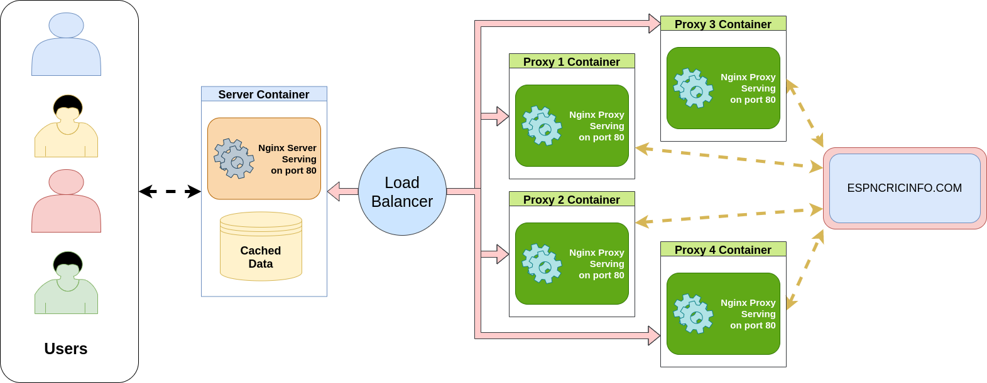
Network Layout

Slide 10
Server setups
Web Server
This is a container running an NGINX Web Server.
It takes requests from users and forwards them to the Proxy Servers. These requests are cached and returned on subsequent requests.
It Handles load balancing of requests to the proxy server using round robin algorithm
Proxy Server
This server takes makes requests to espncricinfo.com and returns it to the main server.
It’s sole purpose is to make requests to espncricinfo.com.

Slide 11


Server Deployment
Each server (Web and Proxy) is deployed within a container.
Containers are brought up using docker and docker compose.
If needed, more proxy servers can be deployed to maintain heavy loads.

Slide 12
Thank You

